Slide 1
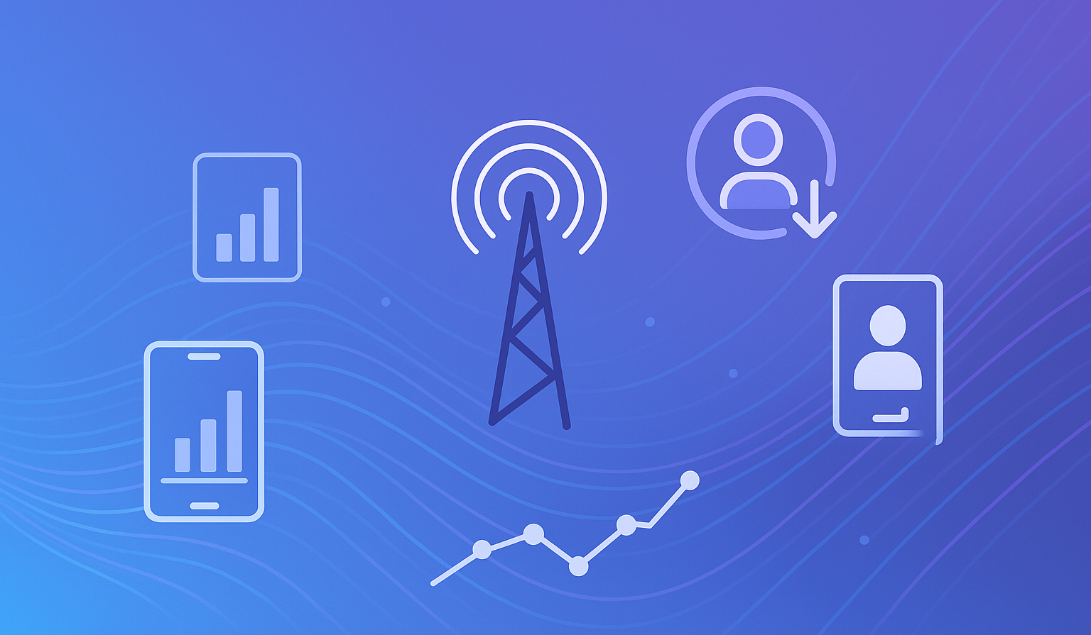
Predicting Customer Churn in Telecommunications Using Logistic Regression and XGBoost
MIE 1628 Cloud-Based Data Analytics - Project Presentation
Basak Kaya
2025-12-09

Slide 2
Project Overview
Goal:
Predict telecom customer churn using machine learning deployed in Microsoft Azure ML.
Objectives:
Analyze telecom customer behavior
Build ML models (Logistic Regression + XGBoost)
Evaluate and compare performance
Explain model results using SHAP
Generate actionable business insights
EDA Modeling SHAP Insights

Slide 3
Dataset Description
Dataset: Iranian Telecom Churn Dataset
Size: 3150 customers
Features: 13 attributes + churn label
Examples:
Usage patterns (seconds of use, SMS, calls)
Customer engagement (subscription length, distinct numbers)
Service indicators (complaints, call failures)
Demographics (age, age group)

Slide 4


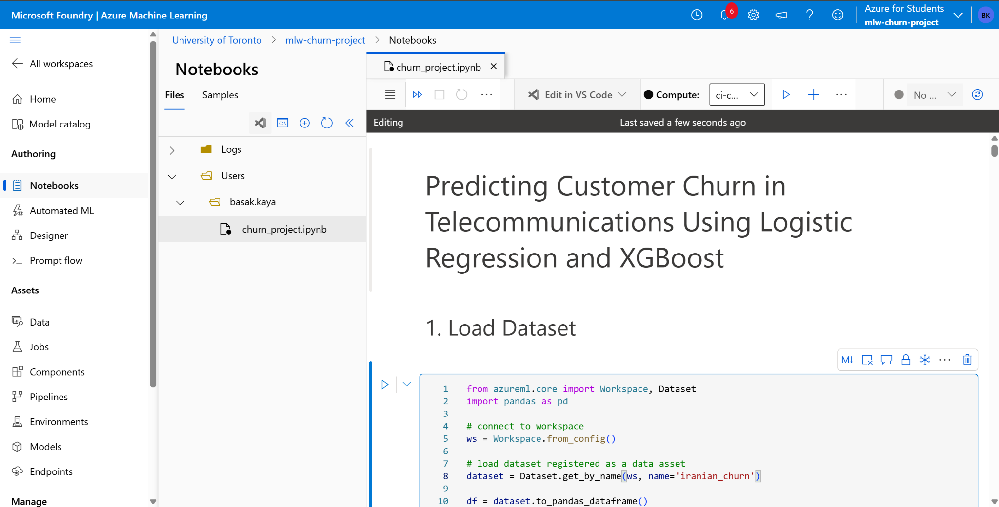
Tools and Technologies
Azure Machine Learning Workspace
Azure Compute Instance for Jupyter
Python (Pandas, Scikit-Learn, XGBoost, SHAP)
Azure Storage for dataset
Matplotlib for visualizations

Slide 5
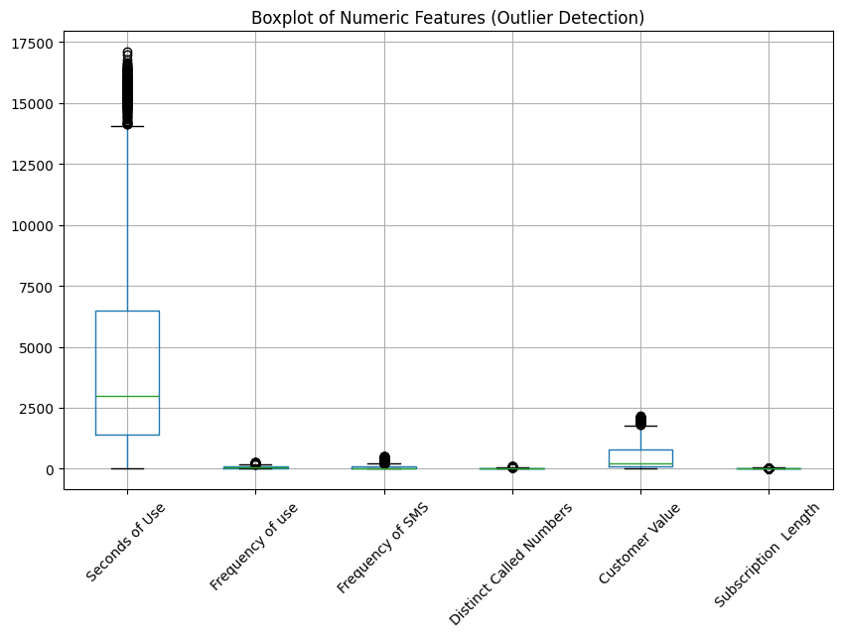
Data Preprocessing & Cleaning
Steps Performed:
Checked for missing values (none found)
Verified data types
Outlier inspection via boxplots
Logical consistency checks
  e.g., zero subscription length + usage
Prepared dataset for ML
  encoding already provided

Slide 6
Exploratory Data Analysis
📉 Data is imbalanced
⚠️ Complaints strongly correlate with churn
📞 Churners show significantly lower usage
📅 Shorter subscription lengths → higher churn likelihood
👩🏻‍🦳 Mid-age groups churn more

Slide 7
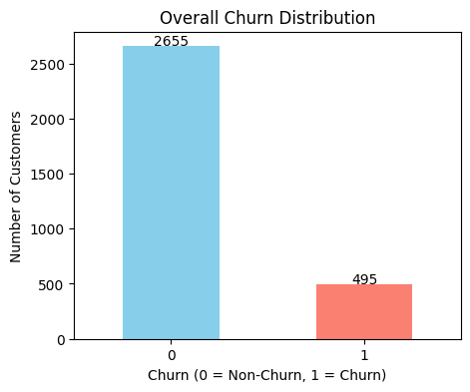
EDA Chart:
Churn Distribution
The dataset is moderately imbalanced.

Slide 8
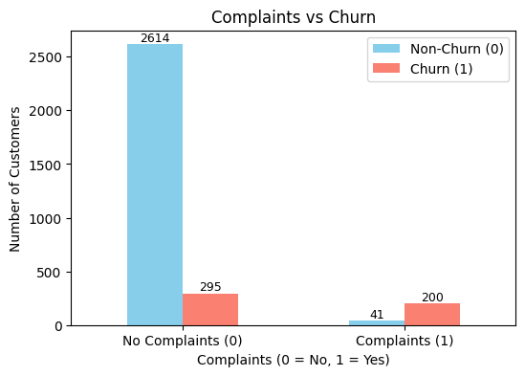
EDA Chart: Complaints vs. Churn
Complaint filers churn far more frequently.

Slide 9
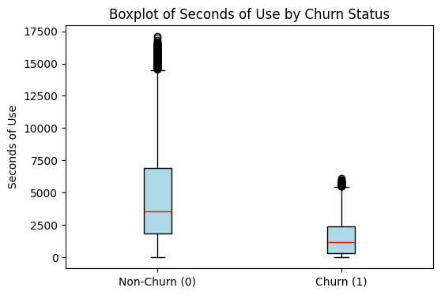
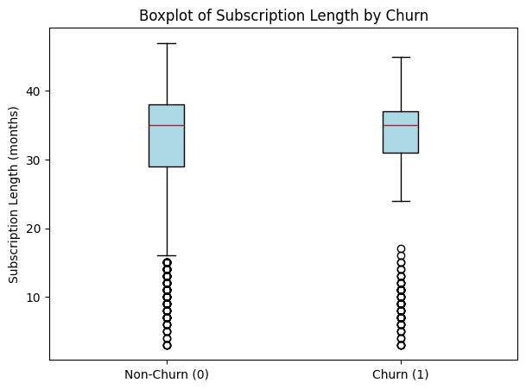
EDA Chart: Usage & Subscription Length
Lower usage + shorter tenure are strong churn indicators.

Slide 10
Modeling Approach
Models Used:
Logistic Regression (with scaling)
XGBoost Classifier
Why These Models:
Logistic Regression → baseline, interpretable
XGBoost → powerful gradient boosting, best performance
Train/Test Split: 70/30 stratified
Metrics: Accuracy, Precision, Recall, F1, ROC-AUC

Slide 11
Model Performance Comparison
Logistic Regression:
Accuracy: 0.844
Precision: 0.50
Recall: 0.89
F1: 0.64
ROC-AUC: 0.93
XGBoost:
Accuracy: 0.949
Precision: 0.88
Recall: 0.79
F1: 0.83
ROC-AUC: 0.98

Slide 12
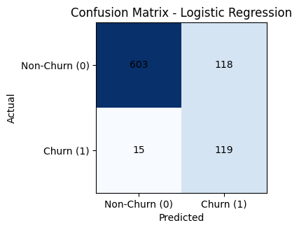
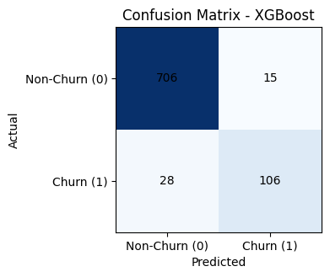
Confusion Matrices
Logistic Regression → high recall, lower precision
XGBoost → balanced and more accurate

Slide 13
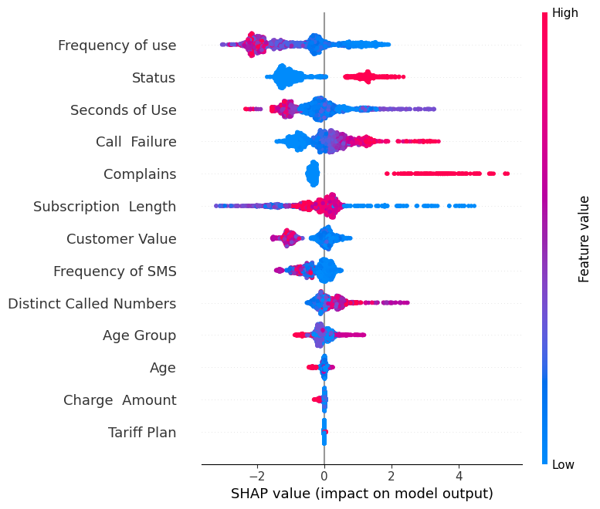
SHAP Interpretability
Insights:
Complaints, subscription length, and usage frequency are top drivers
Lower usage → positive SHAP value → higher churn
High customer value → negative SHAP → retention

Slide 14
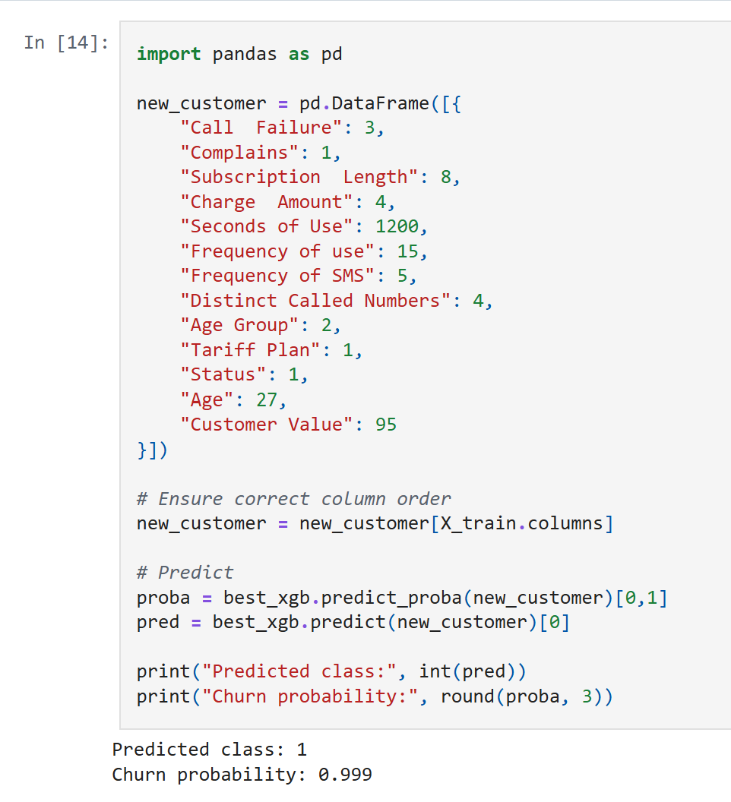
Predicting a New Customer
Predicted class: 1
Churn probability: 0.999
Insight: Model can be used for real-time churn scoring.

Slide 15
Key Takeaways
Churn is heavily influenced by engagement, complaints, and tenure
XGBoost significantly outperformed Logistic Regression
SHAP enabled transparent, explainable ML
Cloud-based ML pipeline built end-to-end in Azure

Slide 16

GitHub Repository
Full Project:
https://github.com/KayaBasak/telecom-churn-xgboost-shap
Includes:
✔ Code
✔ Notebook
✔ Final PDF Report

Slide 17
Thank You!
🐙 GitHub: code + projects
✍️ Medium: more posts like this one
💼 LinkedIn: let’s connect!

